Slide 1
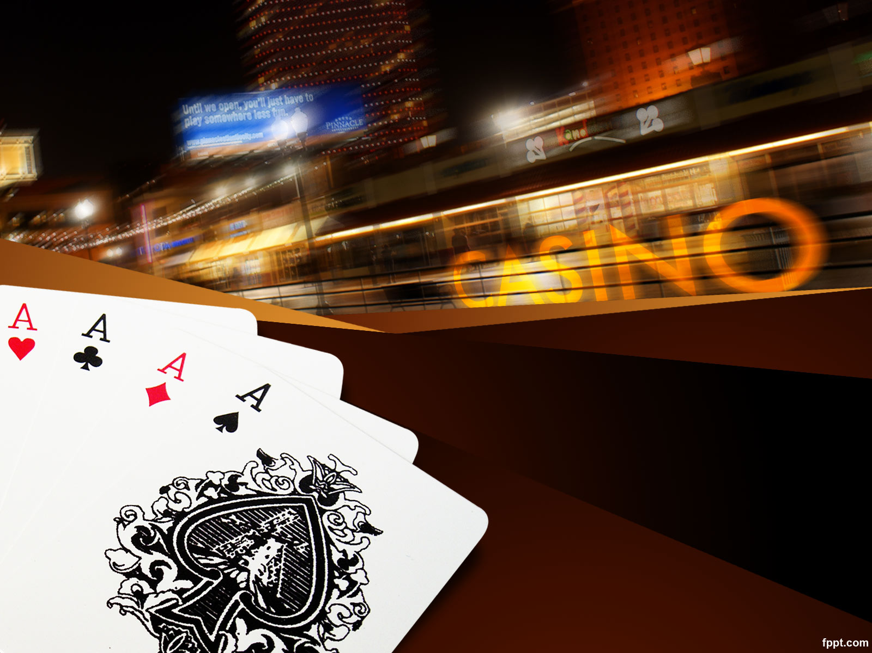
Blackjack Project
By: Yarithe Karim
(Rumon)
Team: HTMALONE

Slide 2

Problem?
People are lonely and shouldn't have to drive to the casino to enjoy a nice low stakes game of Blackjack
Emphasis on low stakes, lonely people should not be gambling just to feel something

Slide 3
Solution : Introduction
My goal in this assignment was to create a blackjack game where people can use fake money to bet. Players will be able to play blackjack with a computer dealer, keep track of their wins and losses, and personalize the gameplay screen in some way.

Slide 4

Goals
Using CSS to design an interactive display where players can:
Interact with cards
Interact with chips
Hover over buttons
Select between 3 options for the look of the game

Slide 5
KANBAN METHODOLOGY
BACKLOG | IN PROGRESS | DONE
MAKE GAME FUNCTIONAL |  | CODE BASIC TABLE
ADD BACKGROUND OPTIONS |  | CODE CARDS AND CHIPS
KEEP TRACK OF PLAYER STATS |  | CODE ANIMATIONS
KEEP TRACK OF MONEY |  | ADD STYLE SWITCHING FEATURE
 |  | VALIDATE AND CHECK CODE
 |  | MAKE SLIDES
 |  | RECORD PRESENTATION

Slide 6
DEMO:
https://codd.cs.gsu.edu/~ykarim1/Blackjack/blackjack.html

Slide 7
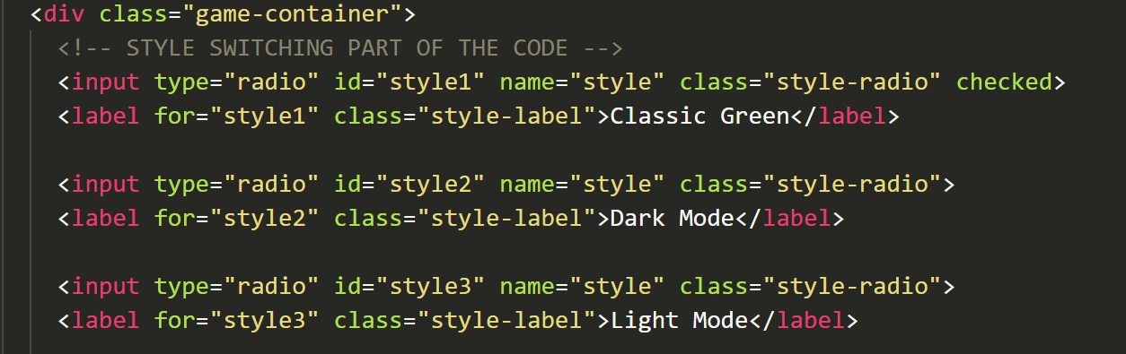
Style Switching Feature: HTML
The style switching feature of the game is created by this segment of the code in HTML. These blocks of code create the buttons that allow the user to switch the theme of the game. The key parts of these include:
input type “radio” means that the button is part of a group of options where only one option can be selected at a time.
id style = “style#” creates unique identifiers for each style which makes sure that each button is linked to its own style.
name = “style” makes sure that each button is in the same group of options (all these buttons are part of the theme selecting options)
class = “style-radio” is what makes it easy for us to style all of the buttons together

Slide 8
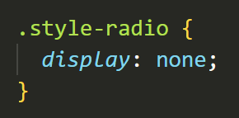
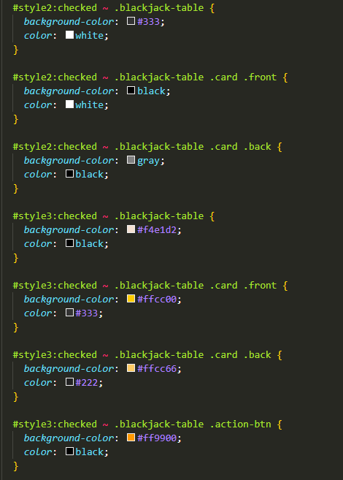
Style Switching Feature: CSS
This is used to make the default radio button UI invisible to make the whole page look cleaner with our other styling.
The CSS here is used to create different styles for each div depending on the selected theme option.
For example:
#style3:checked ~ .blackjack-table .card .back {
background-color: #ffcc66;
color: #222;
}
is used to change the background color and color of the back of each card only when style3 is selected using the previously established radio buttons.

Slide 9
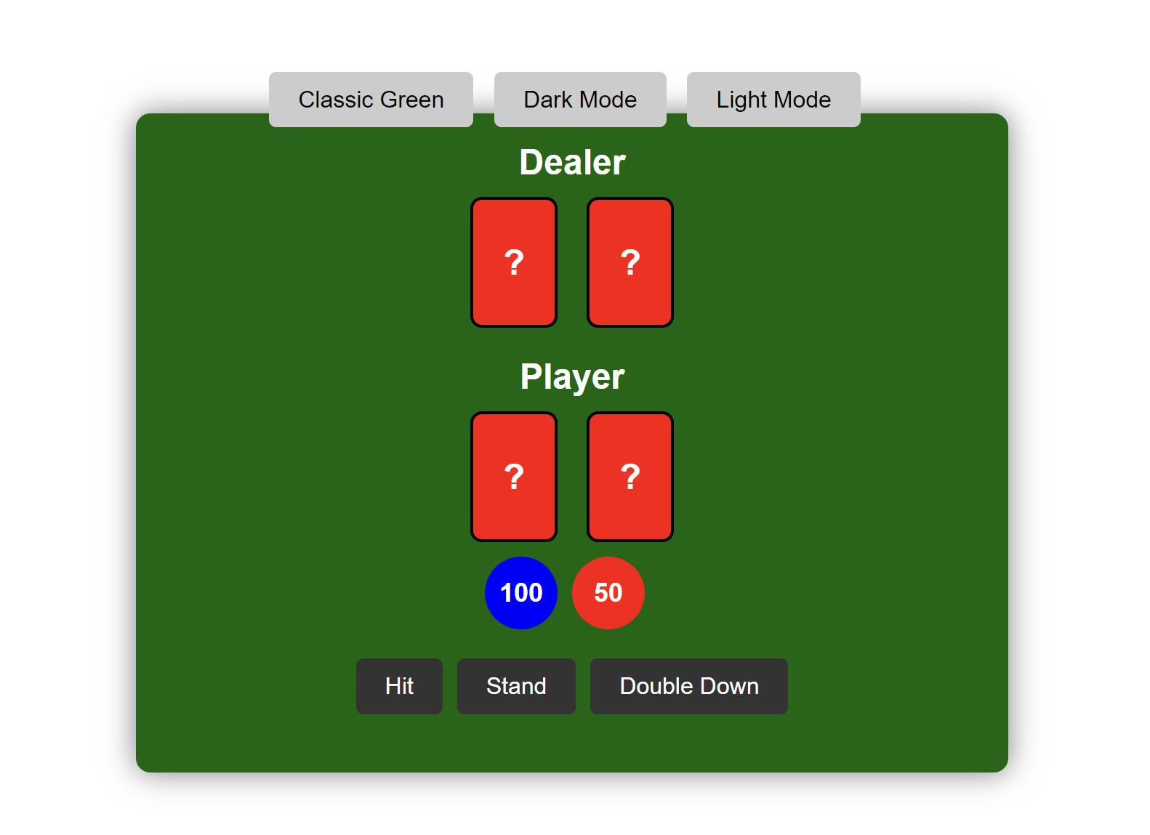
Blackjack Table: Player’s Side

Slide 10
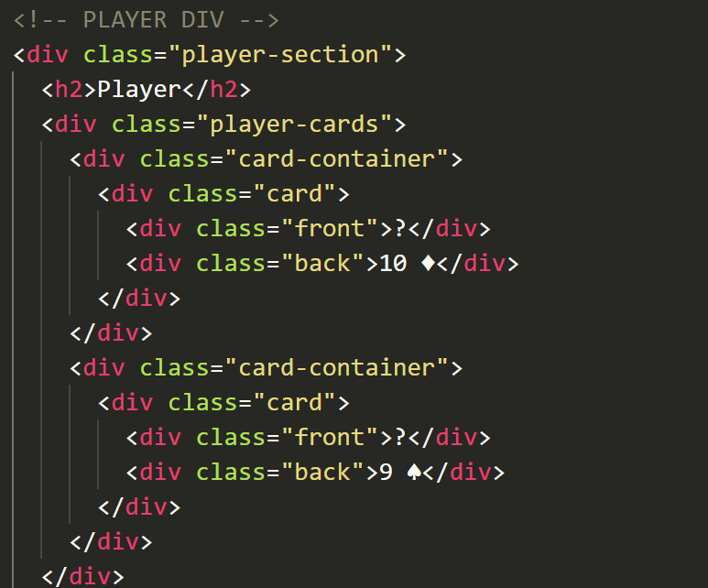
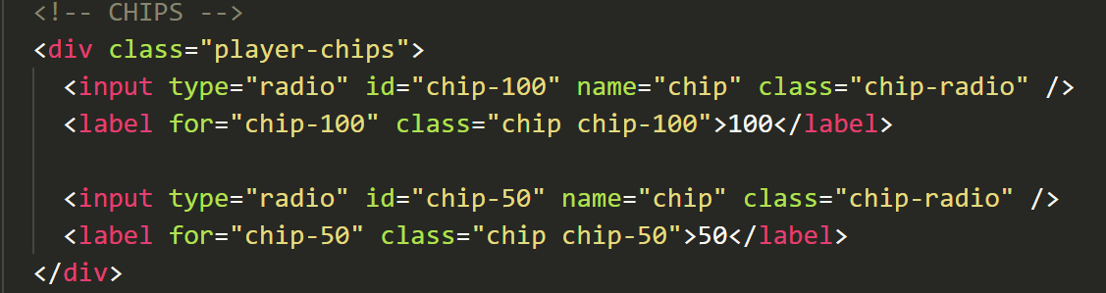
Player’s Section HTML
The HTML side of the Player’s section code consists of nesting divs inside of divs in order to make everything look good and styling all of it together easier. Since we haven’t coded the game aspect yet, filler numbers like 10 and 9 are used on the cards.
The chips are actually radio type buttons since players will later have to choose chips they want to bet when they play the game.

Slide 11
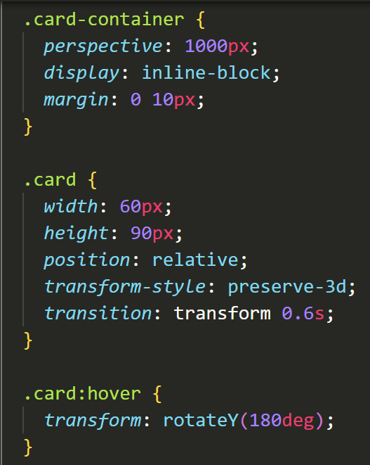
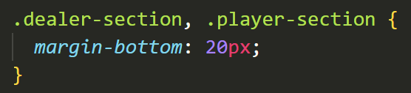
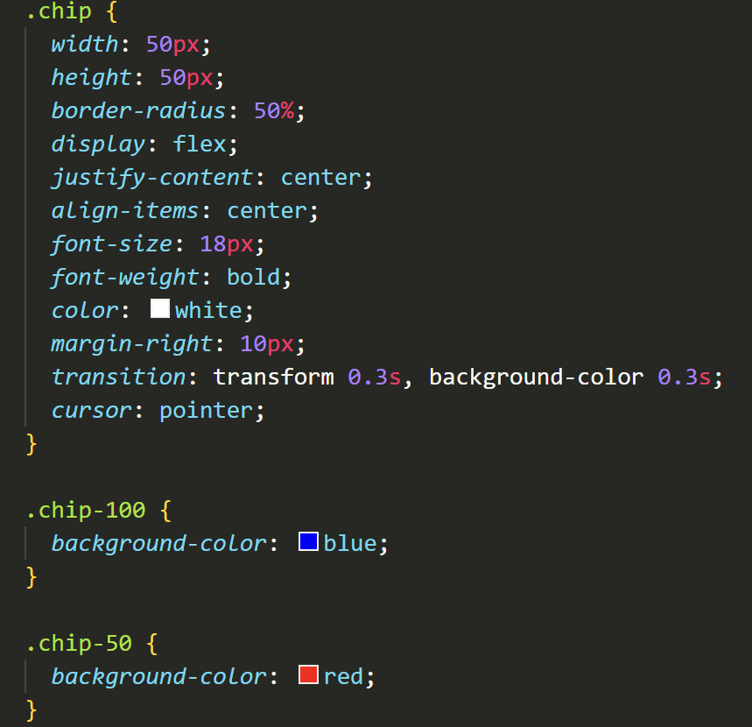
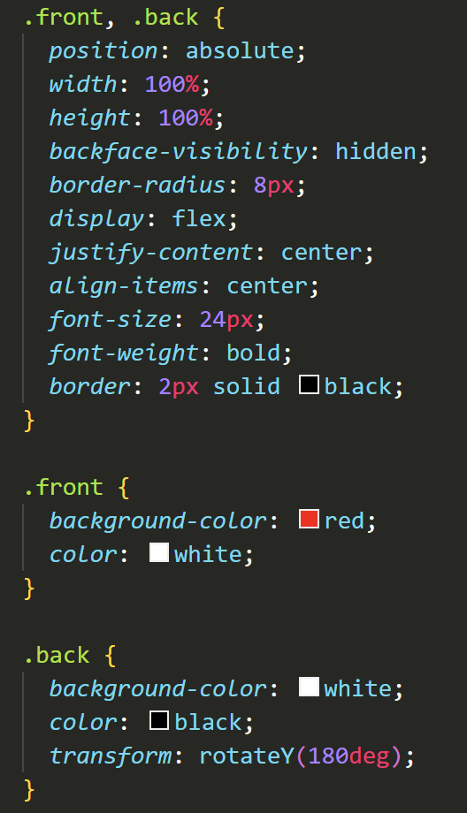
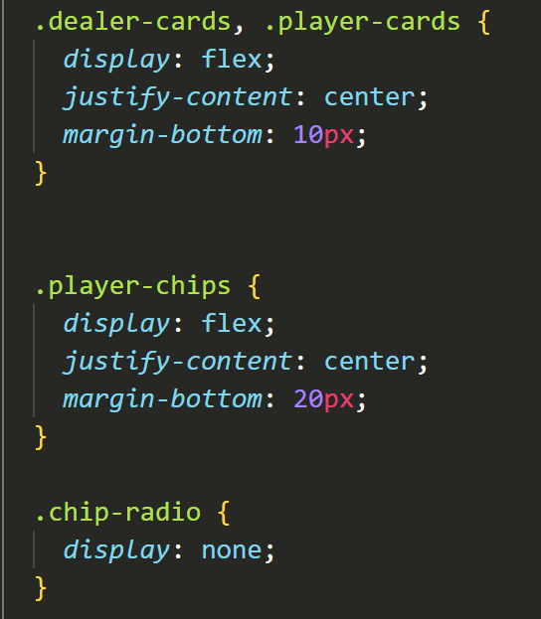
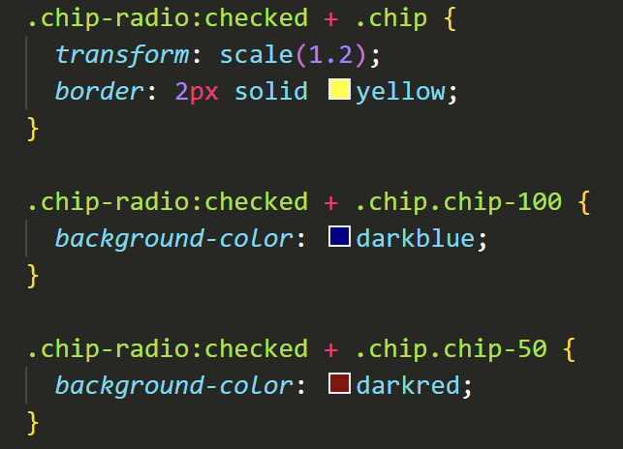
Player’s Section CSS
There’s just too much to go through all of it.

Slide 12
Some CSS examples
This section sets the style for the card-container and the cards.
The cards are given a hover animation in which they rotate by 180 degrees when the player’s mouse hovers over them.
The chip CSS scales the chips to be different sizes and gives them borders. Earlier in the code, 100 chip and the 50 chip have separate style divs to give them different background colors. In this part, they have separate style segments to give them different background colors when they’re clicked by the player

Slide 13
Features to be implemented later:
Functional Blackjack game
Background screen for the table
Player Stats to count wins and losses
System for counting money won and lost

Slide 14
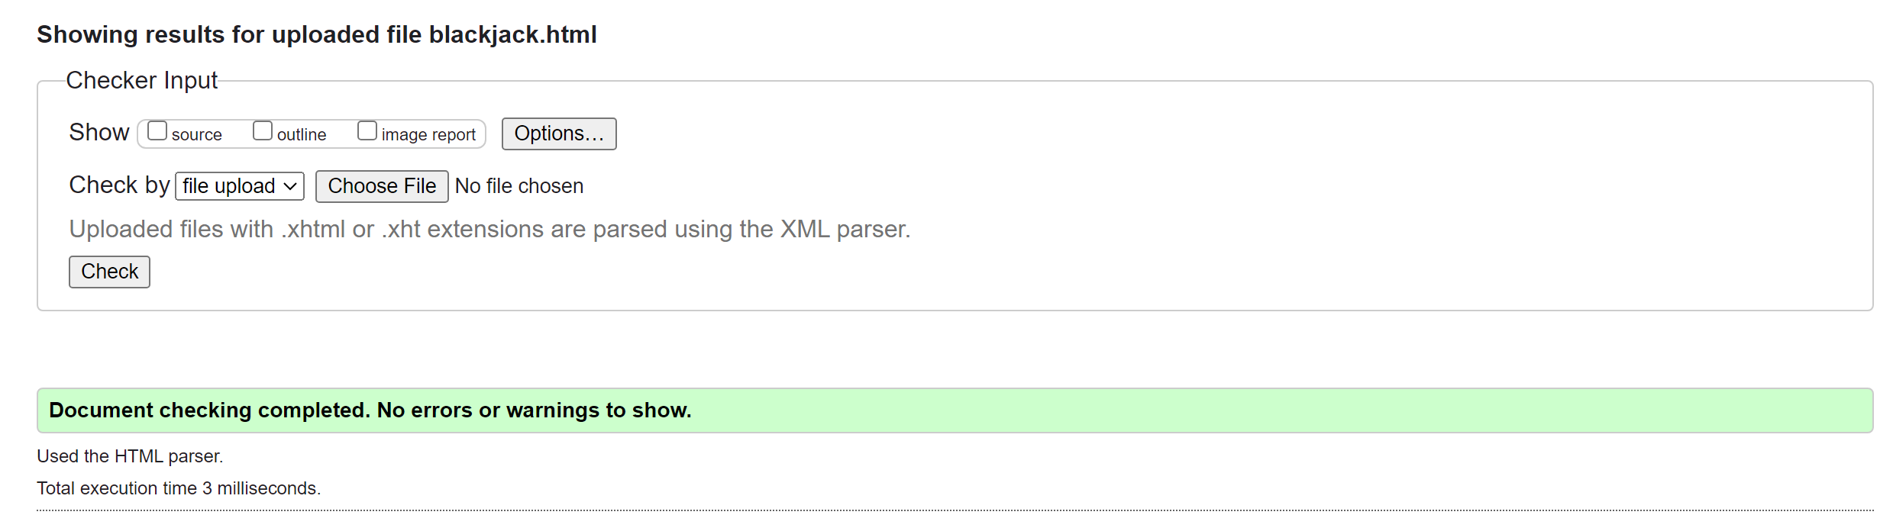
Code Validation
HTML:
CSS:

